Slide 1
Teoh Teik Toe
ITOM/NBS
ttteoh@ntu.edu.sg
97905202
CNN

Slide 2
Image Classification & Clustering
Orange – Inception v3 (2048)
CNN Customized (32,32,64,64|128 dim3136)
Embedding Resnet50 (2048)
Transformer – Google ViT
Code: https://drive.google.com/drive/folders/1fXjR7HWQVDvW4b_UwFmEM_NymlOo4Wbw?usp=sharing
Data:
https://drive.google.com/drive/folders/1DWSSkL9zMwXktar8rxC_3rUGqxwNNTrR?usp=sharing

Slide 3
Part I - CNN

Slide 4
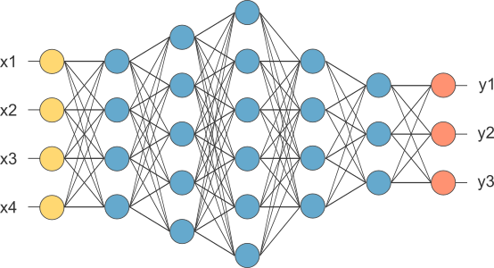
Multi Layer Perceptron
This is our fully connected network. If x_{1 .}... x_{n}, n is very large and growing,
this network would become too large. We now will input one x_{i} at a time,
and re-use the same edge weights.

Slide 5

What is Convolutional NN ?
2x2
Convolution + NL
Sub-sampling
Convolution + NL

Slide 6
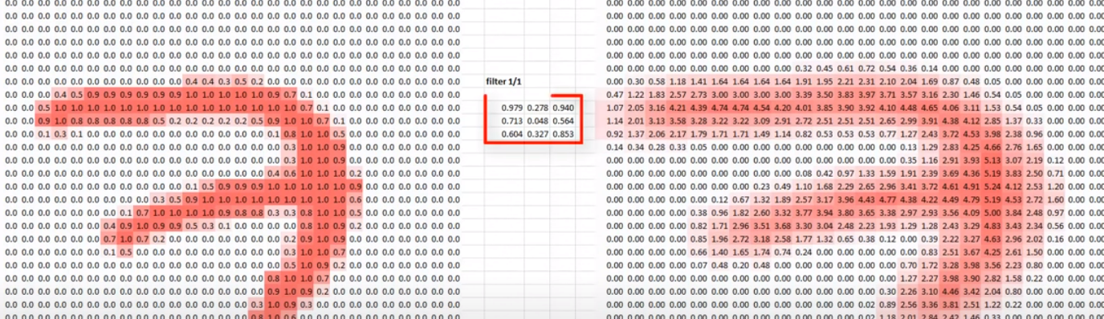
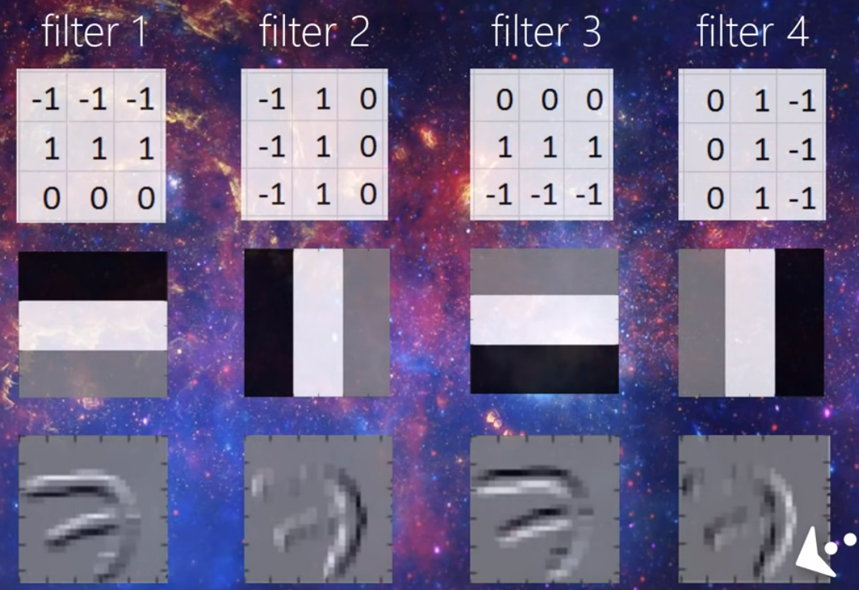
How CNN works

Slide 7
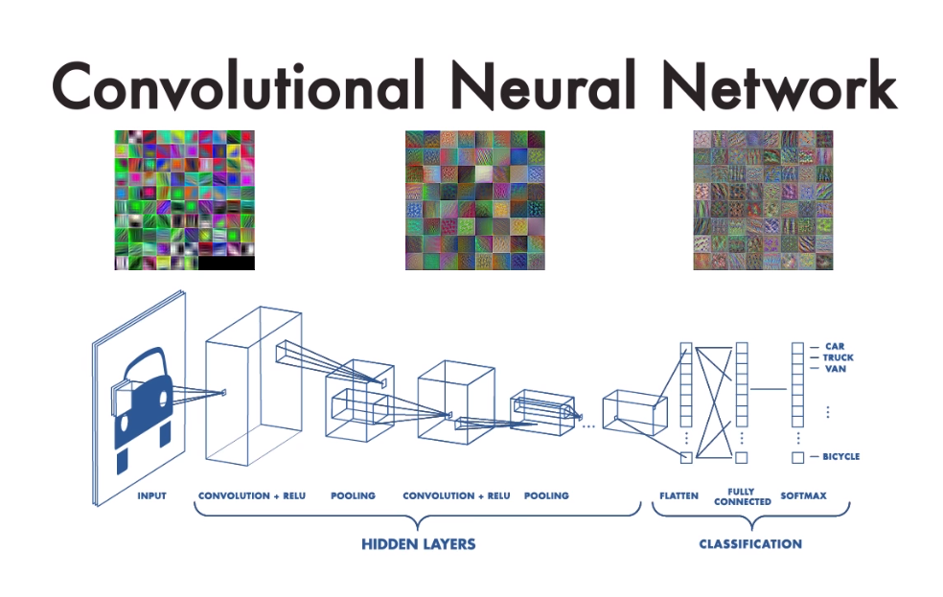

Slide 8
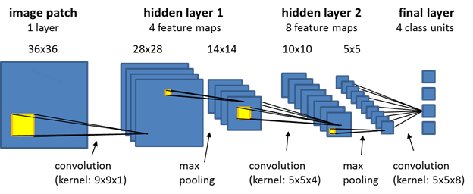
CNN

Slide 9



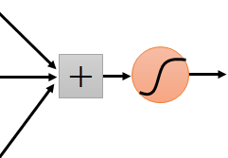


Same pattern appears in different places: They can be compressed! What about training a lot of such “small” detectors and each detector must “move around”.
“upper-left beak” detector
They can be compressed
to the same parameters.
“middle beak” detector

Slide 10
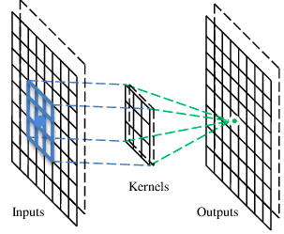
A convolutional layer
A CNN is a neural network with some convolutional layers
(and some other layers). A convolutional layer has a number
of filters that does convolutional operation.
Beak detector
A filter

Slide 11
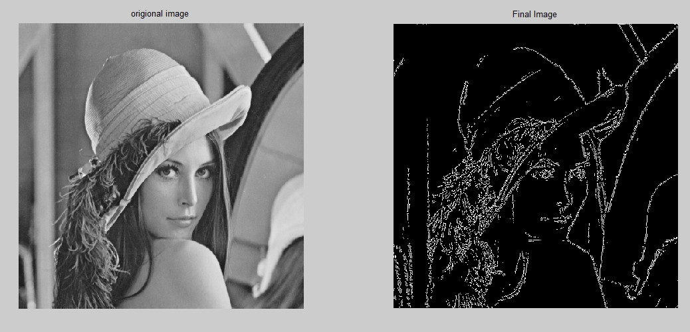
Traditional filter - Sober

Slide 12
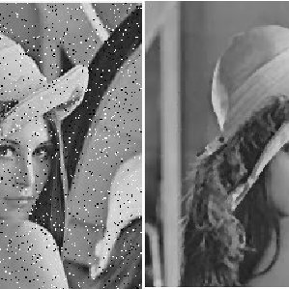
Remove Noise Filter

Slide 13
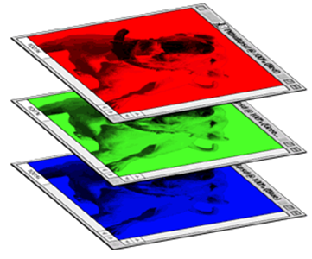
CNN – Colorful image
1 | -1 | -1
-1 | 1 | -1
-1 | -1 | 1
-1 | 1 | -1
-1 | 1 | -1
-1 | 1 | -1
1 | -1 | -1
-1 | 1 | -1
-1 | -1 | 1
-1 | 1 | -1
-1 | 1 | -1
-1 | 1 | -1
1 | -1 | -1
-1 | 1 | -1
-1 | -1 | 1
-1 | 1 | -1
-1 | 1 | -1
-1 | 1 | -1
Filter 1
Filter 2
Colorful image
1 | 0 | 0 | 0 | 0 | 1
0 | 1 | 0 | 0 | 1 | 0
0 | 0 | 1 | 1 | 0 | 0
1 | 0 | 0 | 0 | 1 | 0
0 | 1 | 0 | 0 | 1 | 0
0 | 0 | 1 | 0 | 1 | 0
1 | 0 | 0 | 0 | 0 | 1
0 | 1 | 0 | 0 | 1 | 0
0 | 0 | 1 | 1 | 0 | 0
1 | 0 | 0 | 0 | 1 | 0
0 | 1 | 0 | 0 | 1 | 0
0 | 0 | 1 | 0 | 1 | 0
1 | 0 | 0 | 0 | 0 | 1
0 | 1 | 0 | 0 | 1 | 0
0 | 0 | 1 | 1 | 0 | 0
1 | 0 | 0 | 0 | 1 | 0
0 | 1 | 0 | 0 | 1 | 0
0 | 0 | 1 | 0 | 1 | 0

Slide 14
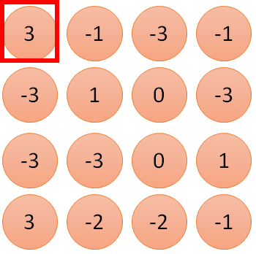
1 | -1 | -1
-1 | 1 | -1
-1 | -1 | 1
1:
1
Filter 1
2:
0
3:
0
3
4:
0
1 | 0 | 0 | 0 | 0 | 1
0 | 1 | 0 | 0 | 1 | 0
0 | 0 | 1 | 1 | 0 | 0
1 | 0 | 0 | 0 | 1 | 0
0 | 1 | 0 | 0 | 1 | 0
0 | 0 | 1 | 0 | 1 | 0
…
7:
0
8:
1
9:
0
10:
0
…
13:
0
6 x 6 image
14:
0
Less parameters!
15:
Only connect to 9 input, not fully connected
1
16:
1
…

Slide 15
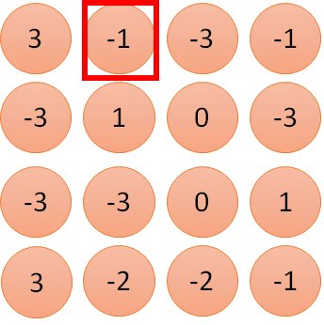
1 | -1 | -1
-1 | 1 | -1
-1 | -1 | 1
1:
1
Filter 1
2:
0
3:
0
3
4:
0
1 | 0 | 0 | 0 | 0 | 1
0 | 1 | 0 | 0 | 1 | 0
0 | 0 | 1 | 1 | 0 | 0
1 | 0 | 0 | 0 | 1 | 0
0 | 1 | 0 | 0 | 1 | 0
0 | 0 | 1 | 0 | 1 | 0
…
7:
0
8:
1
-1
9:
0
10:
0
…
13:
0
6 x 6 image
14:
0
Less parameters!
15:
1
16:
1
Shared weights
Even less parameters!
…

Slide 16
Convolution
1 | -1 | -1
-1 | 1 | -1
-1 | -1 | 1
Filter 1
stride=1
stride=2
1 | 0 | 0 | 0 | 0 | 1
0 | 1 | 0 | 0 | 1 | 0
0 | 0 | 1 | 1 | 0 | 0
1 | 0 | 0 | 0 | 1 | 0
0 | 1 | 0 | 0 | 1 | 0
0 | 0 | 1 | 0 | 1 | 0
1 | 0 | 0 | 0 | 0 | 1
0 | 1 | 0 | 0 | 1 | 0
0 | 0 | 1 | 1 | 0 | 0
1 | 0 | 0 | 0 | 1 | 0
0 | 1 | 0 | 0 | 1 | 0
0 | 0 | 1 | 0 | 1 | 0
3
-1
6 x 6 image
6 x 6 image

Slide 17
Convolution
1 | -1 | -1
-1 | 1 | -1
-1 | -1 | 1
Filter 1
stride=1
1 | 0 | 0 | 0 | 0 | 1
0 | 1 | 0 | 0 | 1 | 0
0 | 0 | 1 | 1 | 0 | 0
1 | 0 | 0 | 0 | 1 | 0
0 | 1 | 0 | 0 | 1 | 0
0 | 0 | 1 | 0 | 1 | 0
3
-1
-3
-1
-3
1
0
-3
-3
-3
0
1
3
-2
-2
-1
6 x 6 image

Slide 18
Convolution
-1 | 1 | -1
-1 | 1 | -1
-1 | 1 | -1
Filter 2
stride=1
Repeat this for each filter
1 | 0 | 0 | 0 | 0 | 1
0 | 1 | 0 | 0 | 1 | 0
0 | 0 | 1 | 1 | 0 | 0
1 | 0 | 0 | 0 | 1 | 0
0 | 1 | 0 | 0 | 1 | 0
0 | 0 | 1 | 0 | 1 | 0
3
-1
-3
-1
-1
-1
-1
-1
-3
1
0
-3
-1
-1
-2
1
Feature
Map
-3
-3
0
1
-1
-1
-2
1
3
-2
-2
-1
6 x 6 image
-1
0
-4
3
Two 4 x 4 images
Forming 2 x 4 x 4 matrix

Slide 19
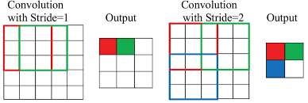
Stride

Slide 20


The whole CNN
cat dog ……
Convolution
Max Pooling
Can repeat many times
Fully Connected Feedforward network
Convolution
Max Pooling
Flattened

Slide 21
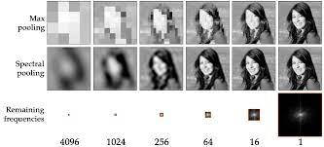
Max Pooling

Slide 22
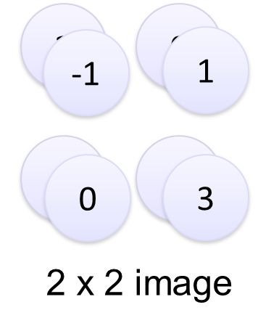
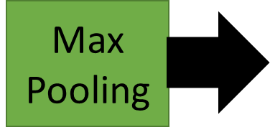
Max Pooling 2x2 stride=2
-1 | 1 | -1
-1 | 1 | -1
-1 | 1 | -1
Filter 2
-1
-1
-1
-1
-1
-1
-2
1
-1
-1
-2
1
-1
0
-4
3

Slide 23


Why Pooling
Subsampling pixels will not change the object
bird
bird
Subsampling
We can subsample the pixels to make image smaller
fewer parameters to characterize the image

Slide 24
The whole CNN
3
0
-1
1
Convolution
3
1
0
3
Max Pooling
Can repeat many times
A new image
Convolution
Smaller than the original image
The number of channels is the number of filters
Max Pooling

Slide 25
Flattening
3
0
1
3
0
-1
1
3
3
1
-1
0
3
Flattened
1
Fully Connected Feedforward network
0
3

Slide 26
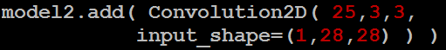
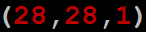
CNN in Keras
Only modified the network structure and input format (vector -> 3-D tensor)
input
Convolution
1 | -1 | -1
-1 | 1 | -1
-1 | -1 | 1
-1 | 1 | -1
-1 | 1 | -1
-1 | 1 | -1
There are 25 3x3 filters.
……
Max Pooling
Input_shape = ( 28 , 28 , 1)
28 x 28 pixels
1: black/white, 3: RGB
Convolution
3
-1
3
Max Pooling
-3
1

Slide 27
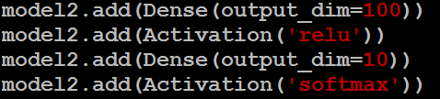
CNN in Keras
Only modified the network structure and input format (vector -> 3-D array)
Input
1 x 28 x 28
Output
Convolution
25 x 26 x 26
Fully connected feedforward network
Max Pooling
25 x 13 x 13
Convolution
50 x 11 x 11
Max Pooling
1250
50 x 5 x 5
Flattened

Slide 28
Output after convolution
in Keras
Input
28 x 28 x 1
26
Convolution
1 | 0 | 0 | 0 | 0 | 1
0 | 1 | 0 | 0 | 1 | 0
0 | 0 | 1 | 1 | 0 | 0
1 | 0 | 0 | 0 | 1 | 0
0 | 1 | 0 | 0 | 1 | 0
0 | 0 | 1 | 0 | 1 | 0
26 x 26 x 32
1 | 0 | 0 | 0 | 0 | 1
0 | 1 | 0 | 0 | 1 | 0
0 | 0 | 1 | 1 | 0 | 0
1 | 0 | 0 | 0 | 1 | 0
0 | 1 | 0 | 0 | 1 | 0
0 | 0 | 1 | 0 | 1 | 0
1 | 0 | 0 | 0 | 0 | 1
0 | 1 | 0 | 0 | 1 | 0
0 | 0 | 1 | 1 | 0 | 0
1 | 0 | 0 | 0 | 1 | 0
0 | 1 | 0 | 0 | 1 | 0
0 | 0 | 1 | 0 | 1 | 0
Convolution
1 | 0 | 0 | 0 | 0 | 1
0 | 1 | 0 | 0 | 1 | 0
0 | 0 | 1 | 1 | 0 | 0
1 | 0 | 0 | 0 | 1 | 0
0 | 1 | 0 | 0 | 1 | 0
0 | 0 | 1 | 0 | 1 | 0
26
24 x 24 x 32
Max Pooling
12 x 12 x 32
32 filters
Flattened

Slide 29
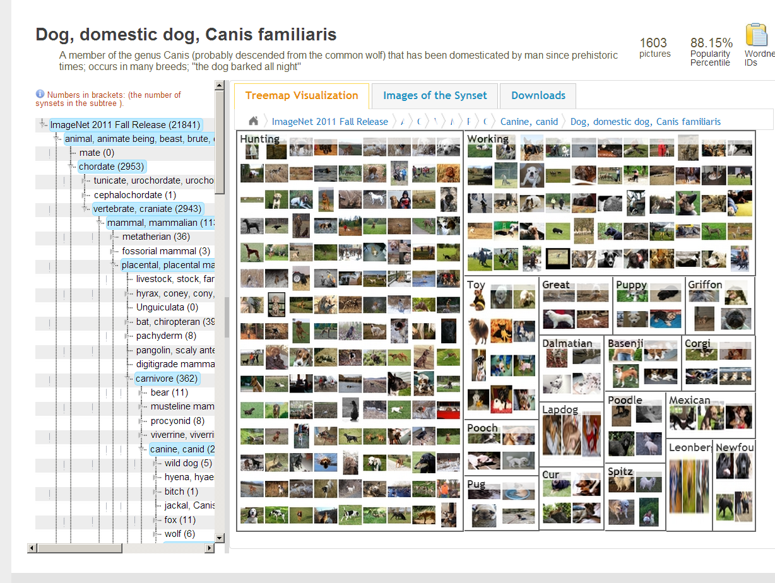
CNN success story: ILSVRC 2012
Imagenet data base: 14 mil labeled images, 20K categories

Slide 30
Conv NN: Detection
Sermanet, CVPR 2014

Slide 31
CNN applications
Transfer learning
Fine-tuning the CNN
Keep some early layers
Early layers contain more generic features, edges, color blobs
Common to many visual tasks
Fine-tune the later layers
More specific to the details of the class
CNN as feature extractor
Remove the last fully connected layer
A kind of descriptor or CNN codes for the image
AlexNet gives a 4096 Dim descriptor
Notes:
http://cs231n.github.io/neural-networks-1/

Slide 32
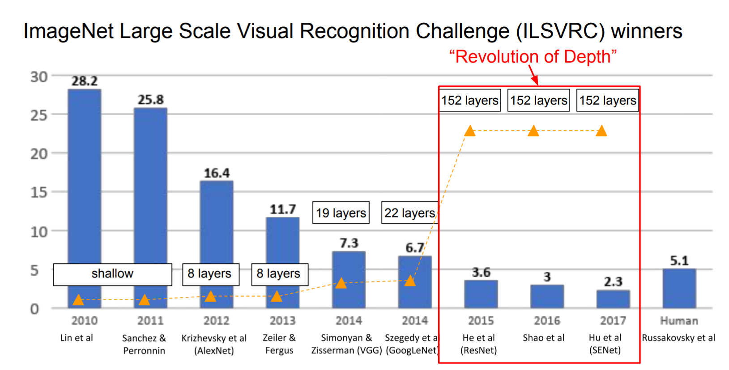
The popular CNN
LeNet, 1998
AlexNet, 2012
VGGNet, 2014
ResNet, 2015
Notes:
http://cs231n.github.io/neural-networks-1/

Slide 33
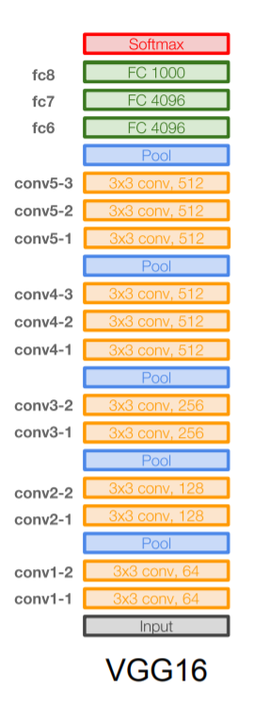
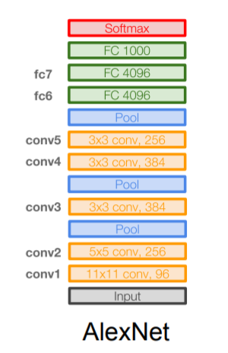
VGGNet
16 layers
Only 3*3 convolutions
138 million parameters

Slide 34
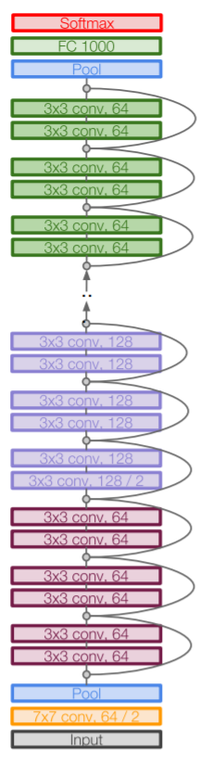
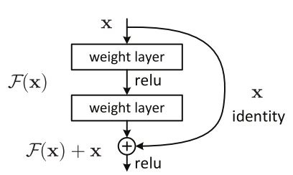
ResNet
152 layers
ResNet50

Slide 35
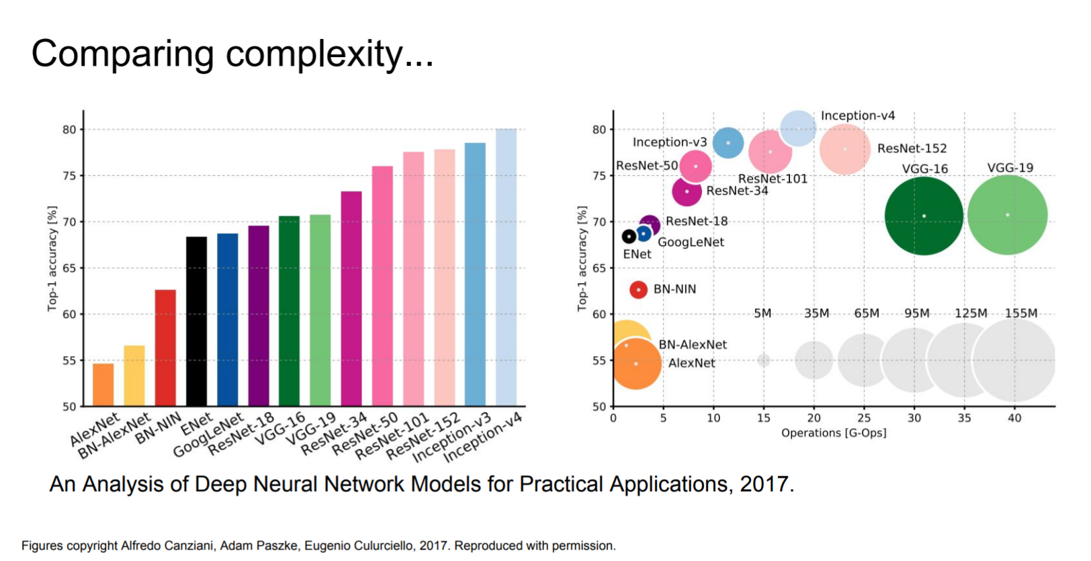
Computational complexity
The memory bottleneck
GPU, a few GB

Slide 36
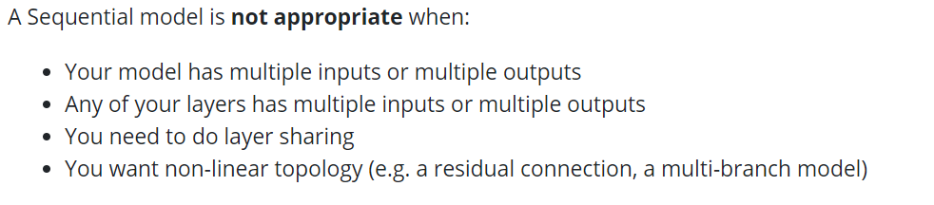
Using Keras Sequential Model https://keras.io/guides/sequential_model/
Add
Compile (Configuration)
Fit (Training)
Evaluate (Test)
Predict (Predict)

Slide 37
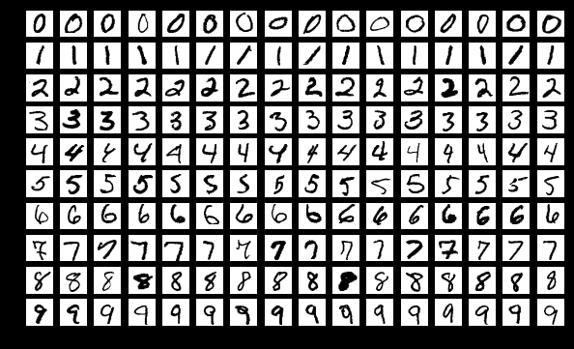
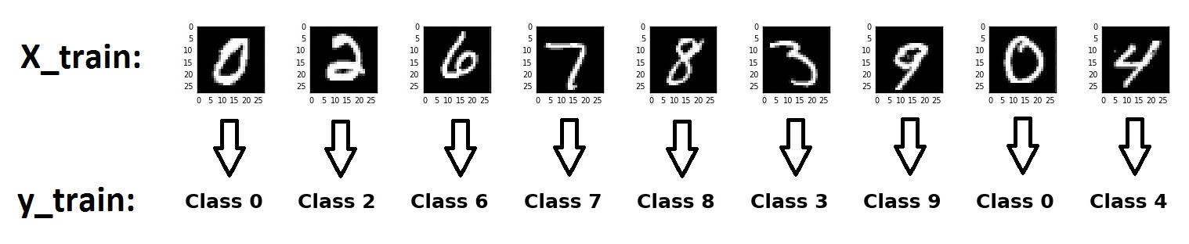
To classified Mnist Using Keras CNN : National Institute of Standards and Technology

Slide 38
Part II

Slide 39
Agenda
Classification using Kaggle data
CNN customized
RESTNET Image Embedding
Orange VGG
Transformer -VIT

Slide 40
Example from Kaggle
#random state
import random
random.seed(1)
import numpy as np
np.random.seed(1)
import tensorflow as tf
tf.random.set_seed(1)

Slide 41
Data from Kaggle
https://www.kaggle.com/datasets/tourist55/alzheimers-dataset-4-class-of-images
https://www.kaggle.com/datasets/paultimothymooney/chest-xray-pneumonia
https://www.kaggle.com/datasets/aryashah2k/breast-ultrasound-images-dataset?resource=download
https://www.kaggle.com/datasets/andrewmvd/medical-mnist
(optional)
Covid: https://tssglobalsingapore-my.sharepoint.com/:f:/g/personal/teohteiktoe_tssglobalsingapore_onmicrosoft_com/EtgAbDvO-HVFi91b7McMxCgBhKIpe2bOU0HIJ_KuIJ6giw?e=0U98mX)

Slide 42
Split train test (if needed)
import splitfolders
input_folder = "C:/Users/Teoh Teik Teo/OneDrive - TSS Global Pte. Ltd/TT Library/AI Model/Data/Breast Illness"
output = "C:/Users/Teoh Teik Teo/OneDrive - TSS Global Pte. Ltd/TT Library/AI Model/Data/Breast Illness (train test split)" #where you want the split datasets saved. one will be created if it does not exist or none is set
splitfolders.ratio(input_folder, output=output, seed=42, ratio=(.7, .1, .2)) # ratio of split are in order of train/val/test. You can change to whatever you want. For train/val sets only, you could do .75, .25 for example.
!pip install split-folders

Slide 43
b = 5
#for colab
pip install keras
pip install tensorflow
from keras.preprocessing.image import ImageDataGenerator
G = ImageDataGenerator()
train = "C:/Users/Teoh Teik Teo/OneDrive - TSS Global Pte. Ltd/TT Library/AI Model/Data/Pneumonia/train"
train_data = G.flow_from_directory(train, (150, 150), batch_size=b, shuffle= False)
test = "C:/Users/Teoh Teik Teo/OneDrive - TSS Global Pte. Ltd/TT Library/AI Model/Data/Pneumonia/test"
test_data = G.flow_from_directory(test, (150, 150), batch_size=b, shuffle= False)

Slide 44
#optional
print(train_data[0][0][0].shape)
# total 4317 data below to 5 clasess
print(len(train_data)) #4317/batch size
print(len(train_data[0])) #2, 1st image, 2nd is label
#print(train_data[0])
print(len(train_data[0][0])) #1st batch of 10 data
print(len(train_data[0][0][0])) #the image, the vertical
print(len(train_data[0][0][0][0])) #the image, the horizontal
print(len(train_data[0][0][0][0][0])) #the image, RGB
#if wanted to display image
from skimage import io
image = io.imread("C:/Users/Teoh Teik Teo/OneDrive - TSS Global Pte. Ltd/TT Library/AI Model/Data/Pneumonia/train/NORMAL/IM-0115-0001.jpeg")
print(image.shape)
io.imshow(image)
Optional:
from matplotlib.pyplot import imshow
import os
from keras.preprocessing.image import array_to_img
img = array_to_img(train_data[0][0][0])
imshow(img)
num_classes = len([i for i in os.listdir(train_root)])
num_classes

Slide 45
from keras.models import Sequential
from keras.layers import Dense, Dropout, Flatten, Conv2D, MaxPooling2D
model = Sequential()
model.add(Conv2D(32, (3, 3), input_shape=(150, 150, 3), activation='relu'))
model.add(MaxPooling2D(pool_size=(2, 2), strides=2))
model.add(Dropout(0.05))
model.add(Conv2D(32, (3, 3), activation='relu'))
model.add(MaxPooling2D(pool_size=(2, 2), strides=2))
model.add(Dropout(0.05))
model.add(Conv2D(64, (3, 3),activation='relu'))
model.add(MaxPooling2D(pool_size=(2, 2), strides=2))
model.add(Dropout(0.2))
model.add(Conv2D(64, (3, 3), activation='relu'))
model.add(MaxPooling2D(pool_size=(2, 2), strides=2))
model.add(Dropout(0.2))
model.add(Flatten())
model.add(Dense(128, activation='relu'))
model.add(Dense(2, activation="softmax")) #depends on class
model.summary()

Slide 46
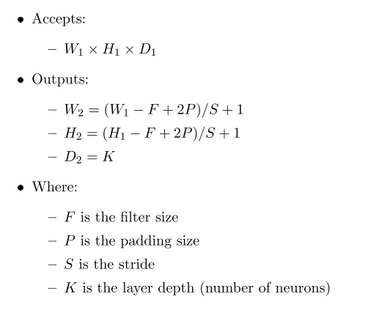
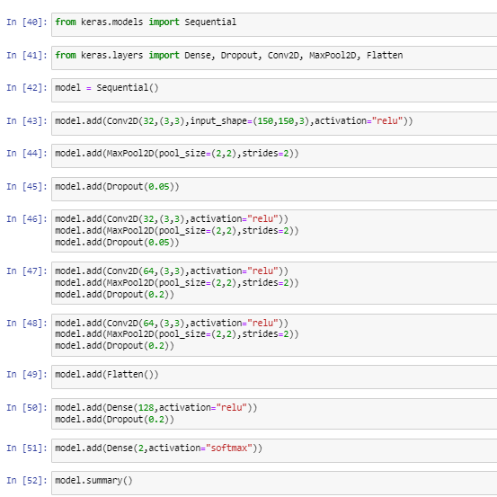
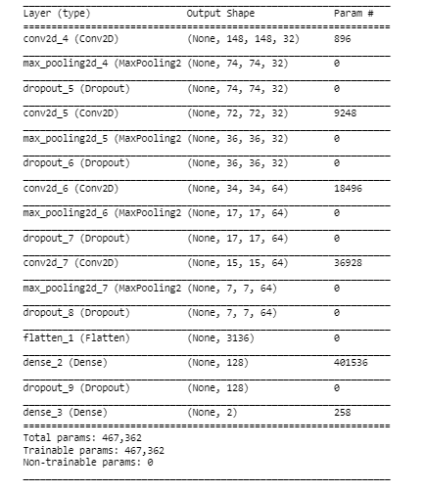
Parameter
150 – 3 (filter size) + 1 (Stride) = 148
148/2 (max pool size)
7 x 7 x 64

Slide 47
#remove optimizer if needed
model.compile(loss="categorical_crossentropy",optimizer="adam",metrics=['accuracy'])
h = model.fit(train_data, batch_size = b, epochs=5)
import matplotlib.pyplot as plt
plt.plot(h.history['accuracy'])
#plt.plot(h.history['val_accuracy'])
plt.title('model accuracy')
plt.ylabel('accuracy')
plt.xlabel('epoch')
plt.legend(['train', 'val'], loc='upper left')
plt.show()
plt.plot(h.history['loss'])
#plt.plot(h.history['val_loss'])
plt.title('model loss')
plt.ylabel('loss')
plt.xlabel('epoch')
plt.legend(['train', 'val'], loc='upper left')
plt.show()

Slide 48
import seaborn as sns
pred = model.predict(test_data)
import numpy as np
pred=np.argmax(pred,axis=1)
from sklearn.metrics import confusion_matrix
cm = confusion_matrix(test_data.classes, pred)
sns.heatmap(cm, annot=True)
#Alternatively pred = pred >= 0.5
A DataFrame object has two axes: “axis 0” and “axis 1”. “axis 0” represents rows and “axis 1” represents columns
#depends on number of classes
print((cm[0,0]+cm[1,1])/(sum(sum(cm))))
from keras.models import save_model
save_model(model, "Pneumonia")
# score = model.evaluate(train_data)
# print(score)
score = model.evaluate(test_data)
print(score)

Slide 49
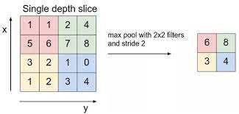
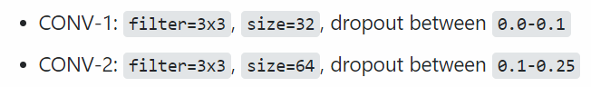
Parameter to configure – Google for the norm
Batch Size (Smaller means more accurate but take more time), usually is 10
Input Size can consider 150, 150
CNN Layer
Change 32 to any number you like, example 64: Conv2D(32, (3, 3))
Change no of CNN layer (Add or Remove)
model.add(Conv2D(64, (3, 3), activation='relu'))
model.add(MaxPooling2D(pool_size=(2, 2), strides=2))
model.add(Dropout(0.05))
Change Dropout rate
Change strides to 1 and try
model.fit(train_data, batch_size = batch_size, epochs=10) – Change batch size (decrease means better result but take more time) and epochs (increase means better result but take more time, if the accuracy keep going up, then need to incarese the epoch further)
Note that epochs need to increase if the results is still improving
model.add(Dense(128, activation='relu’)) – Change 512 to any number you like but try to be smaller than Flatten
model.add(Dropout(0.05)) – try to use 0.2

Slide 50
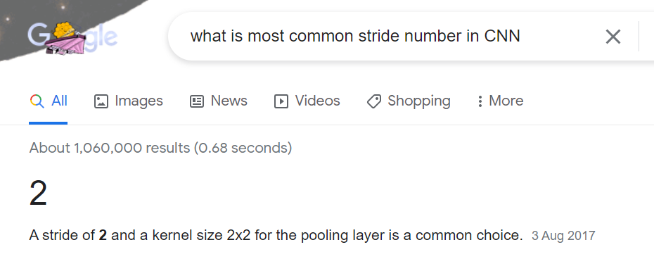
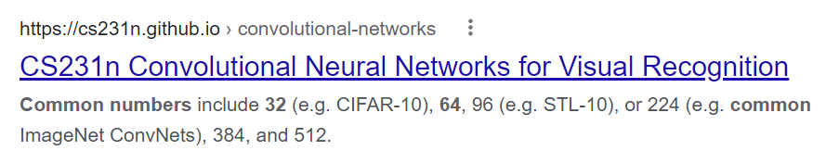
Stride
Number of filter

Slide 51
Exercise Configure CNN
 | Accuracy | Overfitting | Option
Batch Size | Smaller better | Y | 0?
Epoch | Bigger better | Y | 100?
Dropout Rate | Smaller better | Y | 0.2
#neurons | Bigger better | Y | Same as Input
# layer | Bigger Better | Y | 2
Activation Function | Hard to Say | ? | Relu, Sigmoid
Loss | Hard to Say | ? | MSE, Cross Entropy
Optimizer | Hard to Say | ? | Adam (With Momentum, LR)
Metrics | Hard to Say | ? | Accuracy

Slide 52
For Prediction (Grey)
from keras.models import load_model
from PIL import Image #use PIL
import numpy as np
model = load_model("Pneumonia")
image = Image.open("/Users/liqun/Desktop/KS/MyPython/chest_xray/val/NORMAL/NORMAL2-IM-1427-0001.jpeg")
img = np.asarray(image)
img.resize((150,150,3))
img = np.asarray(img, dtype="float32") #need to transfer to np to reshape
img = img.reshape(1, img.shape[0], img.shape[1], img.shape[2]) #rgb to reshape to 1,100,100,3
print(model.predict(img))
from keras.models import load_model
from PIL import Image #use PIL
import numpy as np
model = load_model("Pneumonia")
import cv2
image = cv2.imread("c:/Users/Teoh Teik Teo/OneDrive - TSS Global Pte. Ltd/TT Library/AI Model/Data/Pneumonia/val/NORMAL/NORMAL2-IM-1427-0001.jpeg")
gray = cv2.cvtColor(image, cv2.COLOR_BGR2GRAY)
img = cv2.merge([gray,gray,gray])
img.resize((150,150,3))
img = np.asarray(img, dtype="float32") #need to transfer to np to reshape
img = img.reshape(1, img.shape[0], img.shape[1], img.shape[2]) #rgb to reshape to 1,100,100,3
img.shape
print(model.predict(img))

Slide 53
For Prediction (Color)
from keras.models import load_model
from PIL import Image #use PIL
import numpy as np
model = load_model("Flower")
img = Image.open("rose.jpg") #rose = 3, sunflower = 4, tulip 5
img = img.resize((150,150))
img = np.asarray(img, dtype="float32") #need to transfer to np to reshape
img = img.reshape(1, img.shape[0], img.shape[1], img.shape[2]) #rgb to reshape to 1,100,100,3
img.shape
print(model.predict(img))

Slide 54
Front End
<html>
<h1>Please update the lung X-tray to predict Pneumonia</h1>
<form method="post" action = "/" enctype="multipart/form-data">
<input type="file" name="file">
<input type="submit" value="Upload">
</form>
<p>The result is {{result}}<p>
</html>

Slide 55
from flask import Flask, render_template, request
from werkzeug.utils import secure_filename
from skimage import io
from keras.models import load_model
import cv2 #remove for cloud
from PIL import Image #use PIL
import numpy as np
app = Flask(__name__)
@app.route('/', methods=['GET', 'POST'])
def upload_file():
if request.method == 'POST':
file = request.files['file']
print("File Received")
filename = secure_filename(file.filename)
print(filename)
file.save("./static/"+filename) #remove when cloud
file = open("./static/"+filename,"r") #remove when cloud
model = load_model("Pneumonia")
image = cv2.imread("./static/"+filename) #remove for cloud
gray = cv2.cvtColor(image, cv2.COLOR_BGR2GRAY) #remove for cloud
img = cv2.merge([gray,gray,gray]) #remove for cloud
# for cloud add this (cloud need to use PIL instead of CV2): image = Image.open(file)
# for cloud add this: img = np.asarray(image)
img.resize((150,150,3))
img = np.asarray(img, dtype="float32") #need to transfer to np to reshape
img = img.reshape(1, img.shape[0], img.shape[1], img.shape[2]) #rgb to reshape to 1,100,100,3
pred=model.predict(img)
return(render_template("index.html", result=str(pred)))
else:
return(render_template("index.html", result="WAITING"))
if __name__ == "__main__":
app.run()
Back End (Development Environment)

Slide 56
# Using Resnet
#from tensorflow import keras
#from keras.applications.resnet import ResNet50
#from tensorflow.keras.applications.resnet50 import ResNet50
from keras.applications.resnet50 import ResNet50
from keras.models import Model
import keras
restnet = ResNet50(include_top=False, weights='imagenet', input_shape=(150,150,3))
restnet.summary()
from keras.layers import Conv2D, MaxPooling2D, Flatten, Dense, Dropout, InputLayer
from keras.models import Sequential
from keras import optimizers
model1 = Sequential()
model1.add(restnet)
model1.add(Flatten())
model1.add(Dense(128, activation='relu'))
model1.add(Dropout(0.2))
model1.add(Dense(64, activation='relu'))
model1.add(Dropout(0.2))
model1.add(Dense(num_classes, activation="softmax"))
model1.compile(loss=keras.losses.categorical_crossentropy, optimizer=keras.optimizers.Adam(), metrics=['accuracy'])
history = model1.fit(train_data, batch_size = batch_size, epochs=10)
https://stackoverflow.com/questions/54682539/i-am-not-able-to-import-resnet-from-keras-applications-module
resnet
score = model1.evaluate(test_data)
print(score)

Slide 57
#installation in conda
conda config --add channels conda-forge
conda install libopencv opencv py-opencv
Resnet Image Embedding for Classification and Clustering

Slide 58
import cv2
import numpy as np
import os
# Libraries
from tensorflow.keras.applications import resnet50,ResNet50
from tensorflow.keras.preprocessing import image
model = ResNet50(weights='imagenet', include_top=False, input_shape=(150,150,3))
pip install opencv-python
IMG_SIZE = 100​
photo_train = 300 # set 0 if no max​
photo_test = 150​
What is ImageNet?
Within computer vision and deep learning communities, you might run into a bit of contextual confusion surrounding what ImageNet is and what it isn’t.
You see, ImageNet is actually a project aimed at labeling and categorizing images into almost 22,000 categories based on a defined set of words and phrases. At the time of this writing, there are over 14 million images in the ImageNet project.
So, how is ImageNet organized?
To order such a massive amount of data, ImageNet actually follows the WordNet hierarchy. Each meaningful word/phrase inside WordNet is called a “synonym set” or “synset” for short. Within the ImageNet project, images are organized according to these synsets, with the goal being to have 1,000+ images per synset.

Slide 59
When loading a given model, the “include_top” argument can be set to False, in which case the fully-connected output layers of the model used to make predictions is not loaded, allowing a new output layer to be added and trained

Slide 60
train_dir = "C:/Users/Teoh Teik Teo/OneDrive - TSS Global Pte. Ltd/TT Library/AI Model/Data/Breast Disease (train test split)/train/"
Y_train = []
X_train = []
label = 0
# 2 for loop, 1 for classes and 1 for images in the class
for i in os.listdir(train_dir): #for class
img_num = 0
for j in os.listdir(train_dir+i+'/'): # for images
img=cv2.imread(train_dir+i+'/'+j)
img=cv2.resize(img,(150,150))
img = image.img_to_array(img)
img = resnet50.preprocess_input(np.expand_dims(img.copy(), axis=0))
img = model.predict(img)
X_train.append(img.flatten()/255)
Y_train.append(label)
img_num = img_num + 1
if photo_train != 0:
if img_num >= photo_train:
break
label = label+1

Slide 61
test_dir = "C:/Users/Teoh Teik Teo/OneDrive - TSS Global Pte. Ltd/TT Library/AI Model/Data/Breast Disease (train test split)/test/"
Y_test = []
X_test = []
label = 0
for i in os.listdir(test_dir):
path = test_dir + i
img_num = 0
for j in os.listdir(path):
img=cv2.imread(path+"/"+j)
img=cv2.resize(img,(IMG_SIZE,IMG_SIZE))
img = image.img_to_array(img)
img = resnet50.preprocess_input(np.expand_dims(img.copy(), axis=0))
img = model.predict(img)
X_test.append(img.flatten()/255)
Y_test.append(label)
img_num = img_num + 1
if photo_test != 0:
if img_num >= photo_test:
break
label = label+1

Slide 62
train_dir = "/content/drive/MyDrive/TT Library/AI Model/Data/Breast Disease (train test split)/train/"
Y_train = []
X_train = []
temp = []
temp1 = []
label = 0
# 2 for loop, 1 for classes and 1 for images in the class
for i in os.listdir(train_dir): #for class
temp.append(i)
for j in os.listdir(train_dir+i+'/'): # for images
img=cv2.imread(train_dir+i+'/'+j)
img=cv2.resize(img,(150,150))
img = image.img_to_array(img)
img = resnet50.preprocess_input(np.expand_dims(img.copy(), axis=0))
img = model.predict(img)
X_train.append(img.flatten()/255)
Y_train.append(label)
temp1.append(label)
label = label+1
print(temp)
print(temp1)
IF THE ORDER OF FILES ARE DIFFERENT LIKE BREAST CANCER IN GOOGLE COLAB

Slide 63
test_dir = "/content/drive/MyDrive/TT Library/AI Model/Data/Breast Disease (train test split)/test/"
Y_test = []
X_test = []
label = 0
# 2 for loop, 1 for classes and 1 for images in the class
for i in os.listdir(test_dir): #for class
c = 0
for k in temp:
if i == k:
label = c
print(label)
else:
c = c+1
for j in os.listdir(test_dir+i+'/'): # for images
img=cv2.imread(test_dir+i+'/'+j)
img=cv2.resize(img,(150,150))
img = image.img_to_array(img)
img = resnet50.preprocess_input(np.expand_dims(img.copy(), axis=0))
img = model.predict(img)
X_test.append(img.flatten()/255)
Y_test.append(label)
label = label+1
IF THE ORDER OF FILES ARE DIFFERENT LIKE BREAST CANCER IN GOOGLE COLAB

Slide 64
from sklearn.metrics import confusion_matrix
from sklearn import linear_model
model = linear_model.LogisticRegression().fit(X_train,Y_train)
pred = model.predict(X_test)
cm = confusion_matrix(Y_test,pred)
print((cm[0,0]+cm[1,1]+cm[2,2])/(sum(sum(cm))))
CLASSIFIER
from sklearn.cluster import KMeans
model = KMeans(n_clusters=3, random_state=0)
pred = model.fit_predict(X_train)
cm = confusion_matrix(Y_train,pred)
print((cm[0,0]+cm[1,1])/(sum(sum(cm))))
Clustering
from yellowbrick.cluster import KElbowVisualizer
v = KElbowVisualizer(model,k=(2,20))
v.fit(X_train)
v.show()

Slide 65
#testing the model
# save the model
import joblib
joblib.dump(model,"/content/drive/MyDrive/Colab Notebooks/Image/resnet.jl")
#test the model
img=cv2.imread("/content/drive/MyDrive/TT Library/AI Model/Data/Pneumonia/test/PNEUMONIA/person100_bacteria_477.jpeg")
img=cv2.resize(img,(IMG_SIZE,IMG_SIZE))
img = image.img_to_array(img)
img = preprocess_input(np.expand_dims(img.copy(), axis=0))
img = model.predict(img)
img = img.flatten()/255
import joblib
model = joblib.load("/content/drive/MyDrive/Colab Notebooks/Image/resnet.jl")
model.predict([img])
model.predict_proba([img])

Slide 66
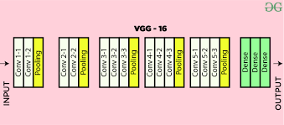
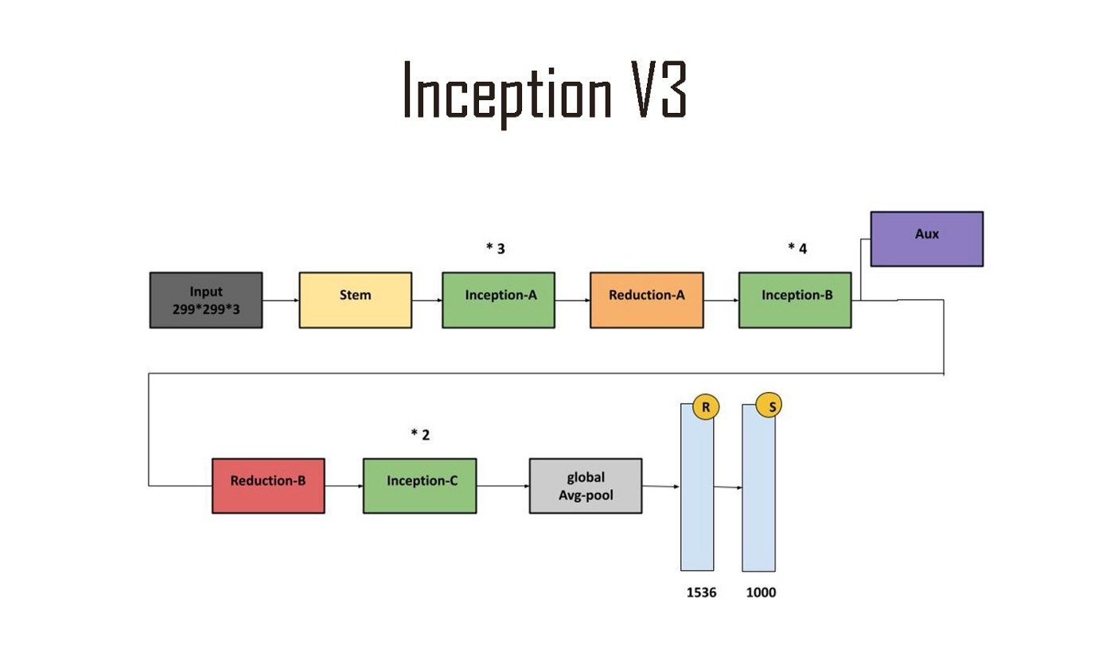
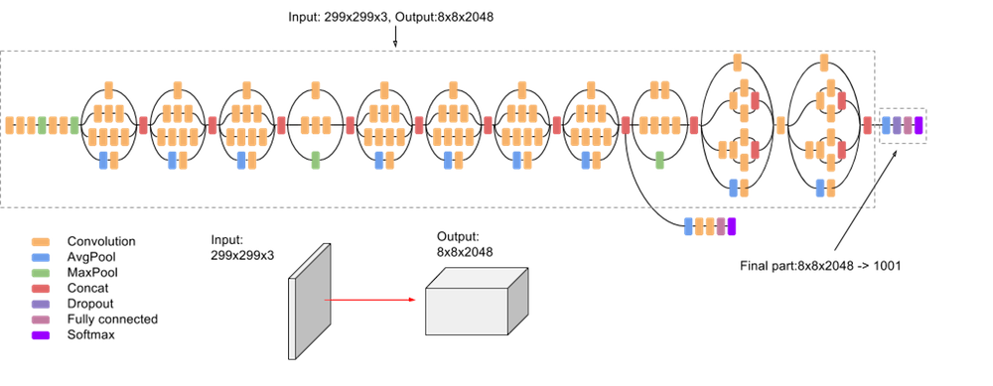
Orange

Slide 67
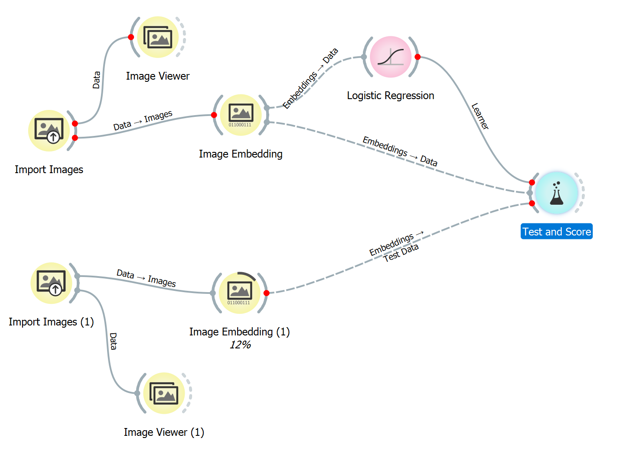
Orange: Can CNN or Resnet do better ? Pneumonia Data

Slide 68
Transformer

Slide 69
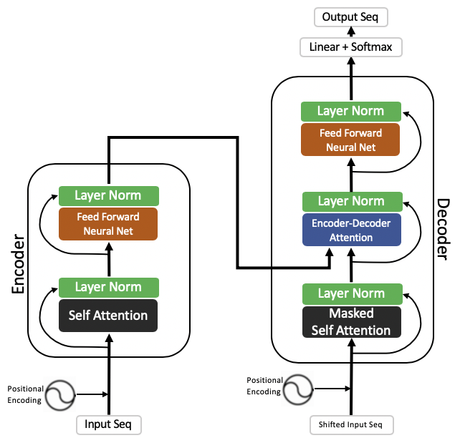
Transformer, Encoder, Attention
The transformer is the model, while the attention is a technique used by the model.

Slide 70
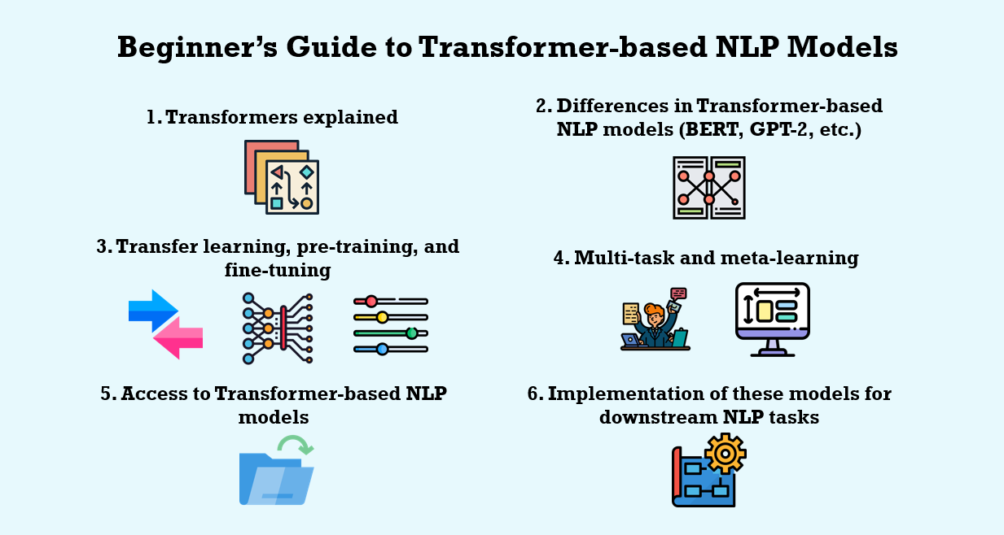
Transformer usage

Slide 71
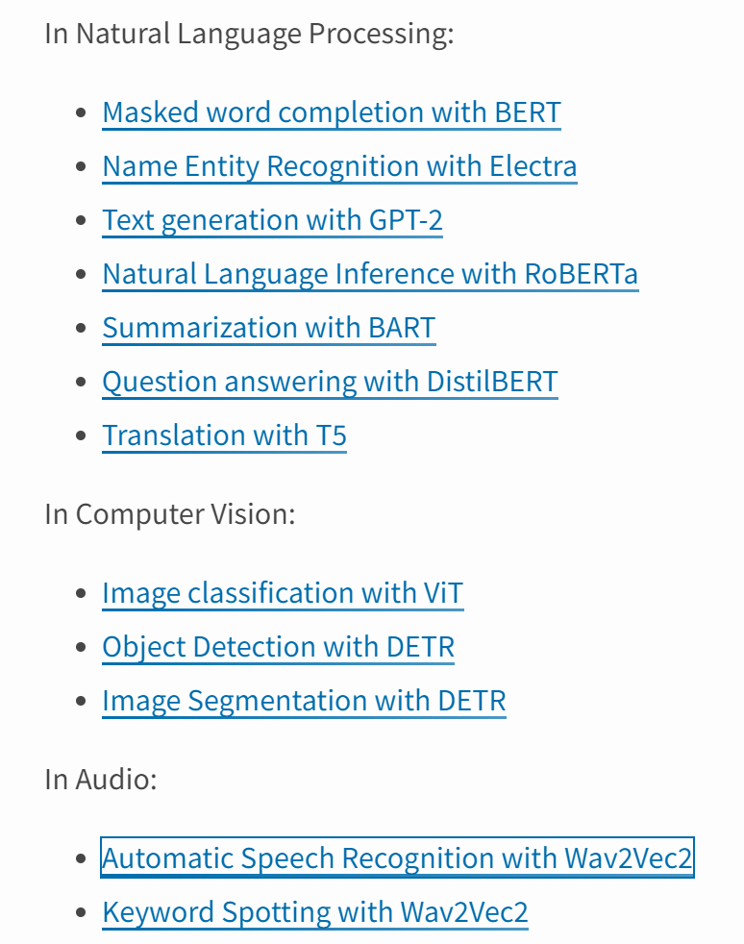
Transformer – Python Library - https://pypi.org/project/transformers/

Slide 72

Transformer in Image: 15m with 22k class
https://pypi.org/project/transformers/
from transformers import ViTFeatureExtractor, ViTForImageClassification
from PIL import Image
import requests
url = 'http://images.cocodataset.org/val2017/000000039769.jpg'
image = Image.open(requests.get(url, stream=True).raw)
feature_extractor = ViTFeatureExtractor.from_pretrained('google/vit-base-patch16-224')
model = ViTForImageClassification.from_pretrained('google/vit-base-patch16-224')
inputs = feature_extractor(images=image, return_tensors="pt")
outputs = model(**inputs)
logits = outputs.logits
# model predicts one of the 1000 ImageNet classes
predicted_class_idx = logits.argmax(-1).item()
print("Predicted class:", model.config.id2label[predicted_class_idx])
Vision Transformer (ViT) model pre-trained on ImageNet-21k (14 million images, 21,843 classes)

Slide 73
Configure you network
Using your own layer and # of neurons
What is the accuracy?

